Slide 1
Case Studies for Quantitative and Qualitative Research
UMD Methods Workshop, November 18, 2019
SoRelle Wyckoff Gaynor

Slide 2
Overview
Why use case studies? When?
How to select case studies
  MMR and quantitative approaches
  Qualitative approaches
Implementing case studies
Group exercise

Slide 3
Case studies – Why? When?
When, and how, you use case studies will largely depend on your your question (Yin 2014)
  Descriptive questions (what is happening or happened)
  Explanatory question (how or why did something happen)
    Vs: Initiative's effectiveness, or how often something happens
  Regression → good for prediction, but not fully understanding
    Understanding adds depth to your research, strengthens your variables and theory
    But it’s also good for the reader – more enjoyable and convincing.
Using a case study will also depend on your data
  Small-n, vs. large-n
  While quantitative is the manipulation after you have data, much of qualitative methods is the very collection of data

Slide 4
Case studies for quantitative research
Mixed methods approach
  “integrative” vs. “triangulation”
    Seawright and Gerring prefer “integrative multi-method research”
  Using the positives of one model to makeup for the weaknesses of the other.
Starting with quantitative analysis
  Lieberman (2005) nested analysis

Slide 5
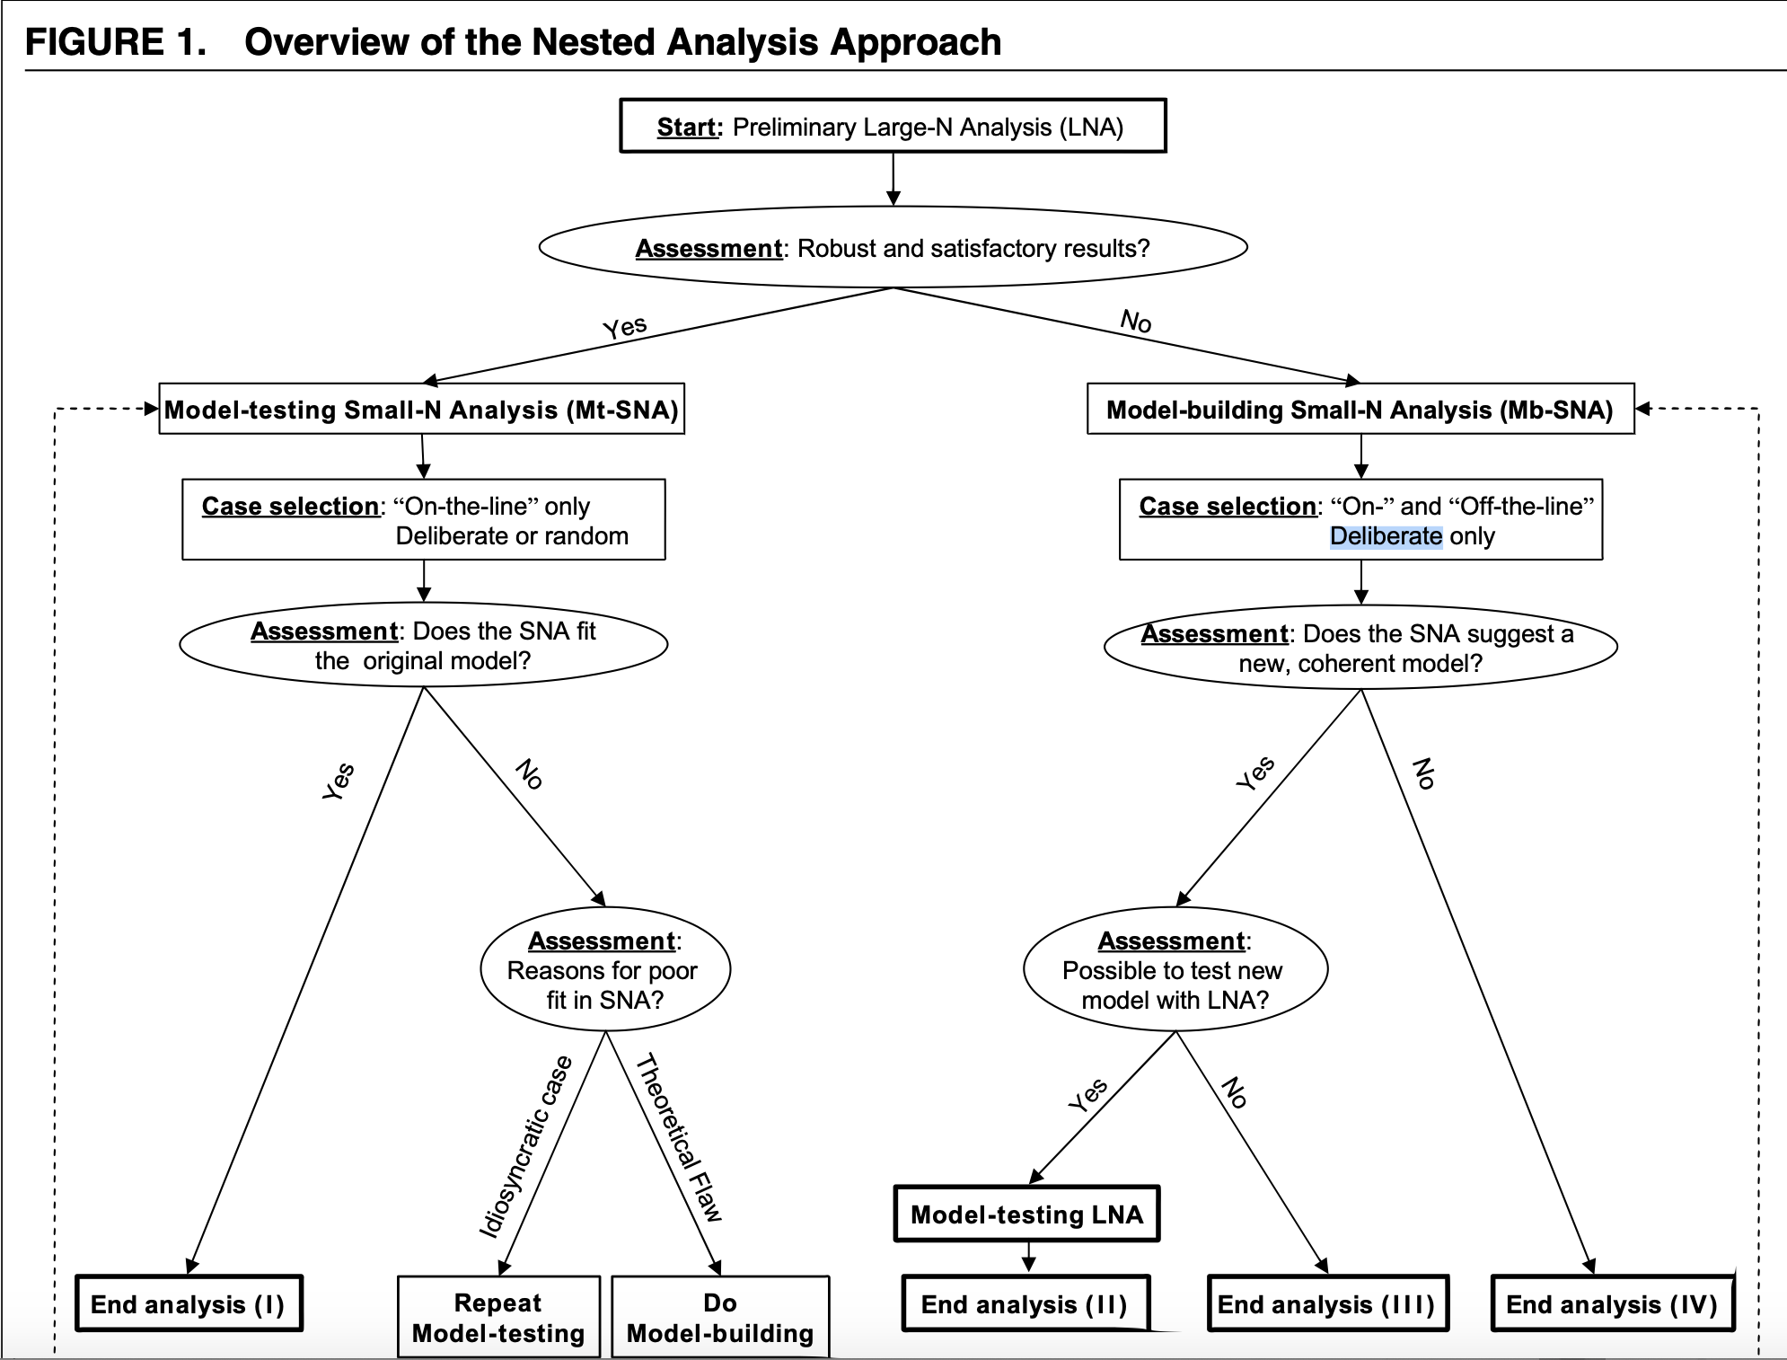
Lieberman, Evan S. “Nested Analysis as a Mixed-Method Strategy for Comparative Research”, American Political Science Review (2005).

Slide 6
Selecting case studies for quantitative research
Mixed methods approach
  “integrative” vs. “triangulation”
    Seawright and Gerring prefer “integrative multi-method research”
  Using the positives of one model to makeup for the weaknesses of the other.
Starting with quantitative analysis
  Lieberman (2005) nested analysis
  Counteracting claims of omitted variable bias
  Selecting based on case variance, or notable IV or DV (Seawright and Gerring 2008)

Slide 7
Seawright and Gerring (2008) case study selection
  Typical case, aka representative case: the puzzle of interest lies within the case. Encapsulates your research and theory. Important: even these cases can be atypical.
  Diverse case: goal is to find cases on the breadth of variance. A researcher should choose high, low, and median variance cases to compare. Here, the interest is in a vector of variables.
  Extreme cases: variable is on the high or low end of an IV or DV of interest. This is a purely exploratory method.
  Deviant case: a case with a surprising value, anomalous. Also a form of exploratory theory-building.
  Influential case: Cases that seem to influence the whole population (anchor points on a regression line). A way to find them to statistically seeing the pull they have (Cook’s statistical test). This is only used when there is reason to be concerned that a select case is driving the results of the larger population.
  Most similar/ most different: employs a minimum of two cases, and compares. Utilizes matching, which is very difficult, but can be estimated.

Slide 8
Seawright and Gerring (2008) case study selection
  Typical case, aka representative case: the puzzle of interest lies within the case. Encapsulates your research and theory. Important: even these cases can be atypical.
  Diverse case: goal is to find cases on the breadth of variance. A researcher should choose high, low, and median variance cases to compare. Here, the interest is in a vector of variables.
  Extreme cases: variable is on the high or low end of an IV or DV of interest. This is a purely exploratory method.
  Deviant case: a case with a surprising value, anomalous. Also a form of exploratory theory-building.
  Influential case: Cases that seem to influence the whole population (anchor points on a regression line). A way to find them to statistically seeing the pull they have (Cook’s statistical test). This is only used when there is reason to be concerned that a select case is driving the results of the larger population.
  Most similar/ most different: employs a minimum of two cases, and compares. Utilizes matching, which is very difficult, but can be estimated.

Slide 9
Seawright and Gerring (2008) case study selection
  Typical case, aka representative case: the puzzle of interest lies within the case. Encapsulates your research and theory. Important: even these cases can be atypical.
  Diverse case: goal is to find cases on the breadth of variance. A researcher should choose high, low, and median variance cases to compare. Here, the interest is in a vector of variables.
  Extreme cases: variable is on the high or low end of an IV or DV of interest. This is a purely exploratory method.
  Deviant case: a case with a surprising value, anomalous. Also a form of exploratory theory-building.
  Influential case: Cases that seem to influence the whole population (anchor points on a regression line). A way to find them to statistically seeing the pull they have (Cook’s statistical test). This is only used when there is reason to be concerned that a select case is driving the results of the larger population.
  Most similar/ most different: employs a minimum of two cases, and compares. Utilizes matching, which is very difficult, but can be estimated.

Slide 10
Selecting case studies for quantitative research
Mixed methods approach
  “integrative” vs. “triangulation”
    Seawright and Gerring prefer “integrative multi-method research”
  Using the positives of one model to makeup for the weaknesses of the other.
Starting with quantitative analysis
  Lieberman (2005) nested analysis
  Counteracting omitted variable bias
  Selecting based on case variance, or notable IV or DV (Seawright and Gerring 2008)
  Would not recommend random sampling (Seawright 2019)
Ending with quantitative analysis
  Using case studies to build your variables of interest (ex: Fearon and Laitin 2003)

Slide 11
Selecting case studies for qualitative research
Yin (2014) approach:
Define the case
  A “case” is generally a bounded entity (a person, organization, behavioral condition, event, or other social phenomenon), but the boundary between the case and its contextual conditions—in both spatial and temporal dimensions—may be blurred.
Select one of four case study designs
  Single or multiple case x embedded vs. holistic study
Using theory in design work
  Do you let it frame your work, or do you evolve your theory after examining the cases?
  A case study that begins with some theory will be easier to implement

Slide 12
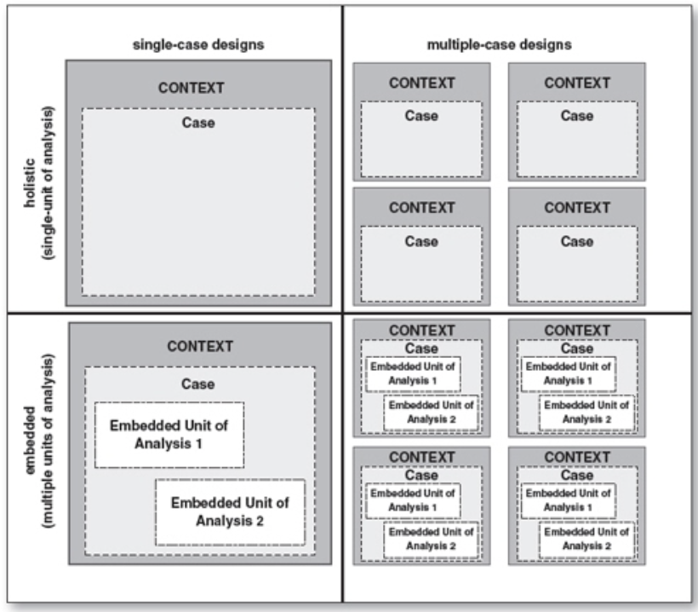
Yin, Robert K. “Applications of Case Study Research”, Ch. 1, Fig. 1 (2014)

Slide 13
Selecting case studies for qualitative research
Within-case analysis
  Historical analysis and phenomena (LBJ, French Revolution)
  Good for theory building (Gerring would disagree)
Cross-case analysis
  “integrative” vs. “triangulation”. This time, triangulation is the goal.
  More robust than single-case analysis
For all of these, it’s best to proactively consider and select on the IV or DV
  What are you trying to explain?
  Consider transferability
For qualitative case studies, selection comes at the beginning, analysis follows.
  Interpretation is the analysis
  Process tracing

Slide 14
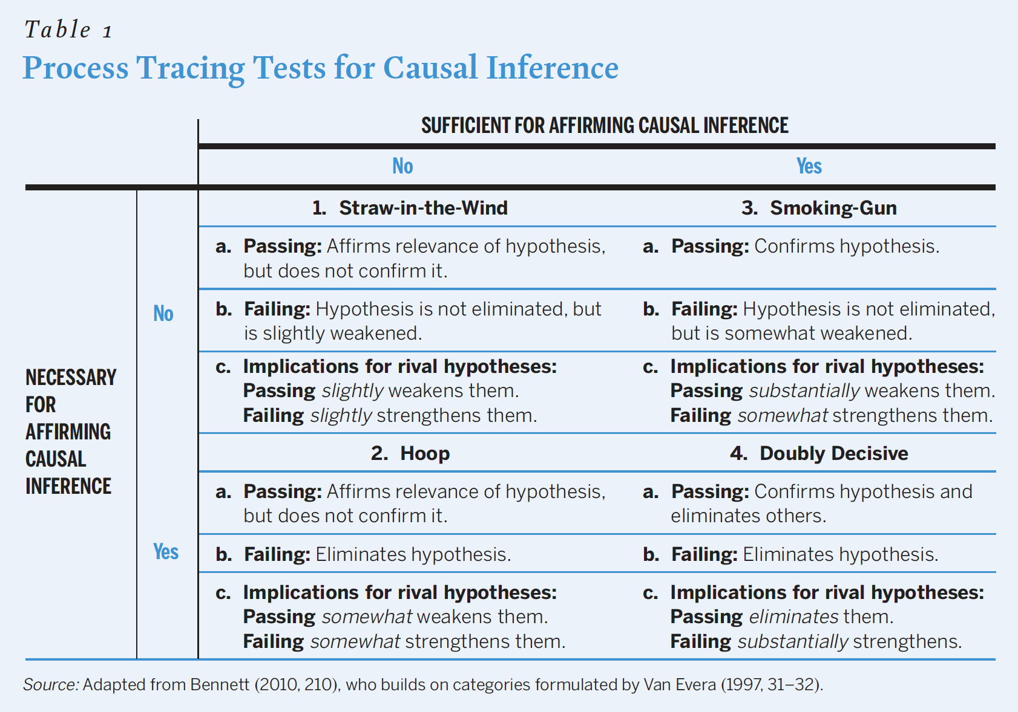
Collier, David. “Understanding Process-Tracing” PS. 2011.

Slide 15
And then what? Analyzing case studies
As with all qualitative research, the key is DETAIL.
Best practices for collecting and documenting studies:
  Multiple sources of evidence (direct observations, interviews, archival research, documents, participation-observation, physical artifacts)
    This is a form of “triangulating”
  You should develop protocol (coding or collecting), explain it, and stick to it
  Seek data to explain rival explanations and be skeptical
  When presenting, it needs to be clear, providing both an explanation of the findings and methods
  Case studies and interpretation are NOT the same thing! Don’t assume the reader has the same historical or environmental understanding as you.

Slide 16
And THEN what? Implementing case studies
Implementing in quantitative research
  “Mini-case analysis” (Huth 1996)
  Dissertation chapters
  The case study supplements the research and acts as a robustness check
Implementing in qualiative research
  The case selection and variable analysis IS the research
  Single-case and historical analysis (Orloff and Skocpol 1984)
Basic questions to answer regardless:
  What was the purpose of the study
  What was the design
  Who or what was studied
  How was data analyzed

Slide 17
Group exercise

